Slide 1
SIP & OP
(Leadership & Governance)
OLIVER R. CARIASO
Planning Officer III

Slide 2
In the percentage of your readiness in crafting your SIP, what is the first step you did?
Give a document as source of school data in determining your PIAs.
What are the contents of the AIP?
What is the difference between AIP & WFP?
How often do you revisit your SIP for adjustments?
Where did you derived the PAPs you have in your OP?

Slide 3

Identification of PIA
Data collection
Data analysis
Identification of gaps

Slide 4
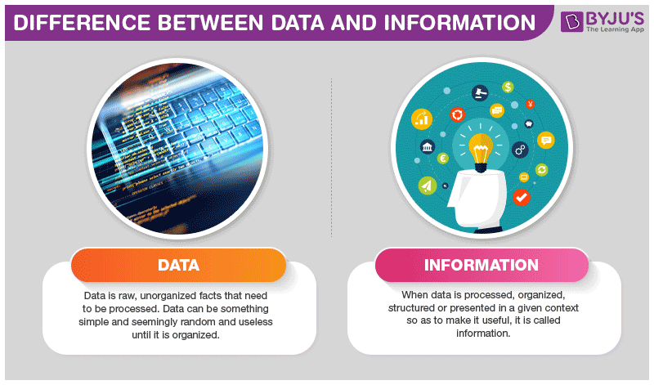

Data vs Information
Data
Information

Slide 5
Data vs Information
Basco CS
Diptan ES
Valugan IS
Tukon ES
Chanarian ES
Mahatao ES
Diura BS
San Vicente ES
Ivana ES
Uyugan ES
Itbud IS
Imnajbu ES
Savidug ES
Sabtang CS
Sumnanga ES
Nakanmuan ES
Chavayan ES
Mayan ES
Yawran BS
Itbayat CS
Raele IS
Itbayat NAHS
Batanes NSHS
Batanes GCHS
Mahatao NHS
Sabtang NSF
Ivana NHS

Slide 6
Data vs Information
Basco CS
Batanes GCHS
Batanes NSHS
Chanarian ES
Chavayan ES
Diptan ES
Diura BS
Imnajbu ES
Itbayat CS
Itbayat NAHS
Itbud IS
Ivana ES
Ivana NHS
Mahatao ES
Mahatao NHS
Mayan ES
Nakanmuan ES
Raele IS
Sabtang CS
Sabtang NSF
San Vicente ES
Savidug ES
Sumnanga ES
Tukon ES
Uyugan ES
Valugan IS
Yawran BS

Slide 7
Gaps
They are prospects for improvement wherein it could be a school process or part of a school process based on baseline data

Slide 8
Gap analysis

Slide 9
Assign a Teacher as Project Proponent to Address the PIA
Project Name: Project KEEP
Problem Statement: The school registered an increasing trend of SLs for the last 3 years
Project Objective Statement: To reduce SLR from 2.3% to 0.38%
Root Cause: Financial concerns; Health Problems; Child Labor

Slide 10
Annual Implementation Plan
An annual implementation plan is a plan which outlines exactly how you will be reaching your goals for the year, and who in your team is responsible for that outcomes. It links strategic goals and objectives to tactical goals and objectives.

Slide 11
Annual Implementation Plan
AIP is detailed plan encompassing actions, roles, responsibilities, timelines and success criteria for the next 12 months, leading to the achievement of the School Improvement Plan.
It is based on the general objectives and targets set in the SIP.
It elaborates on how key improvement strategies and other significant projects will be put into operation, monitored and evaluated.

Slide 12
Annual Implementation Plan
Parts of the AIP
      The Physical Plan
      The Timeframe
      The Resources Needed

Slide 13
Physical Plan
The Physical Plan contains the performance targets of the unit’s key or major programs and projects.
Example:
To reduce SLR from 2.3% to 0.38%
Notes:
Difference between SLR & SDR
The target decreased is derived from dividing 2.3 by 6 yrs = 0.38 decrease every year

Slide 14
Physical Plan

Slide 15
Time Frame

Slide 16
Resources Needed

Slide 17
What is the WFP?
The Work and Financial Plan (WFP) is a budget execution document (BED) which summarizes how the budget of an office is programmed for the whole fiscal year.
The WFP is composed of three (3) separate but synchronized parts:
  Physical Plan
  Monthly Obligation Plan
  Monthly Disbursement Plan

Slide 18
The Physical Plan contains the performance targets of the unit’s key or major programs and projects.

Slide 19
The Monthly Obligation Program reflects the cost needed to conduct the activity considering the budget ceiling set by the management and/or the approved budget as reflected in the GAA.

Slide 20
WFP Highlights
The WFP answers the following:
  What are the office’s programs?
  What are the outputs of each program?
  What activities will be conducted to produce the outputs?
  When will the activities be conducted?
  How much will each activity cost?
  When will the amount be obligated?
  When will the amount be disbursed?

Slide 21
Functions of the WFP
The WFP is a:
  Documentation of the office’s annual plan
  Tool for monitoring & evaluation
    Physical & financial targets vis-à-vis accomplishments
    RMEA, DMEA, & SMEA
    PIR (Program/Performance Implementation Review)
The WFP ensures that all activities:
  Are aligned to a higher level objective
  Have a ready budget (for funded PAPs)
  Are scheduled properly

Slide 23
SIMPLE DROPOUT RATE
Calculates the percentage of learners who do not finish a particular grade level.
Does NOT capture learners who finish a grade level,
but do not enroll in the next grade level the following school year.

Slide 24
SCHOOL LEAVER RATE
Internationally known as the dropout rate.
It covers both learners who do not finish a particular grade level as well as those who finish but fail to enroll in the next grade level the following school year

